Slide 1
Genetic Non Linear Polynomial Discriminant Analysis GNLPDA
Director: Héctor Gabriel Acosta Mesa
Codirector: Adriana Laura López Lobato
Ángel García Báez
22/05/2026

Slide 2
For this session
Show workflow progress
Show results with statistical test

Slide 3
Calendar January - September 2026
Activity | 2026
 | January | February | March | April | May | June | July | August | September
Review of the protocol
Review of the literature and state of the art
Problem definition and methodology
Design and implementation of the proposed algorithm
Experiments and validation (using real and simulated data)
Calibration of the proposed algorithm
Writing of chapters and figures
Writing and revision of Chapter 1
Writing and revision of Chapter 2
Writing and revision of Chapter 3
Review by the thesis committee
Writing an article based on the findings of the thesis
Thesis defense
Research internship

Slide 4
Basic information
Thesis main goal
Develop and implement a feature extraction framework that combines polynomial expansion with classical dimensionality reduction LDA, using an intelligent selection mechanism, to improve the separability and visualization of nonlinear data.
Thesis hypothesis
A polynomial expansion will allow us to achieve levels of accuracy statistically equivalent to those of the most advanced nonlinear models, with the added advantage of filtering out dimensional redundancy to generate visualizable 1D, 2D, and at most 3D projections that reveal the dispersion structure of the classes.

Slide 5
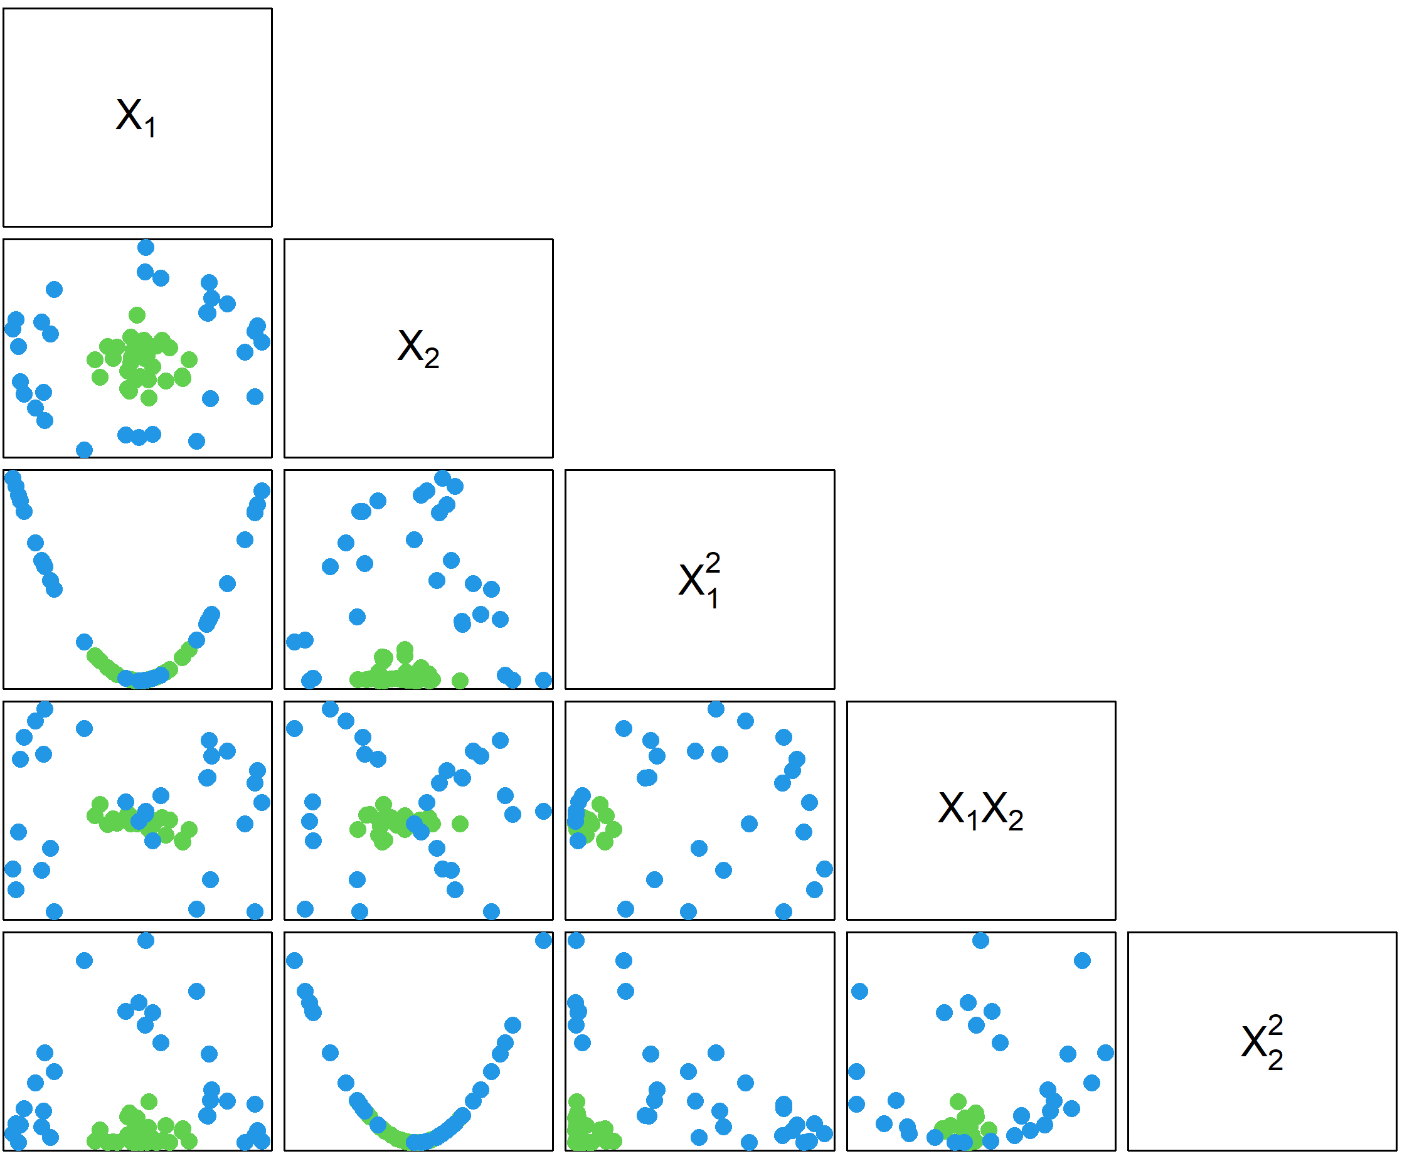
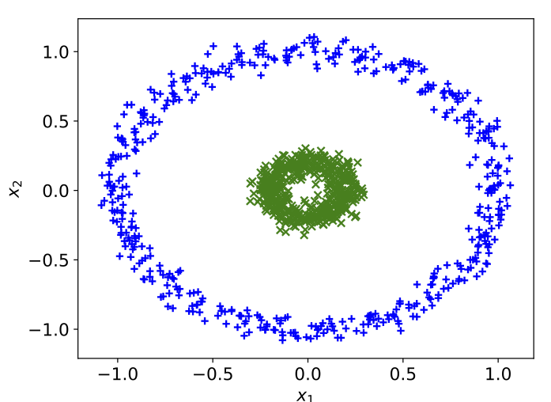
Expectations
A | B | A^2 | B^2 | AB

Slide 6
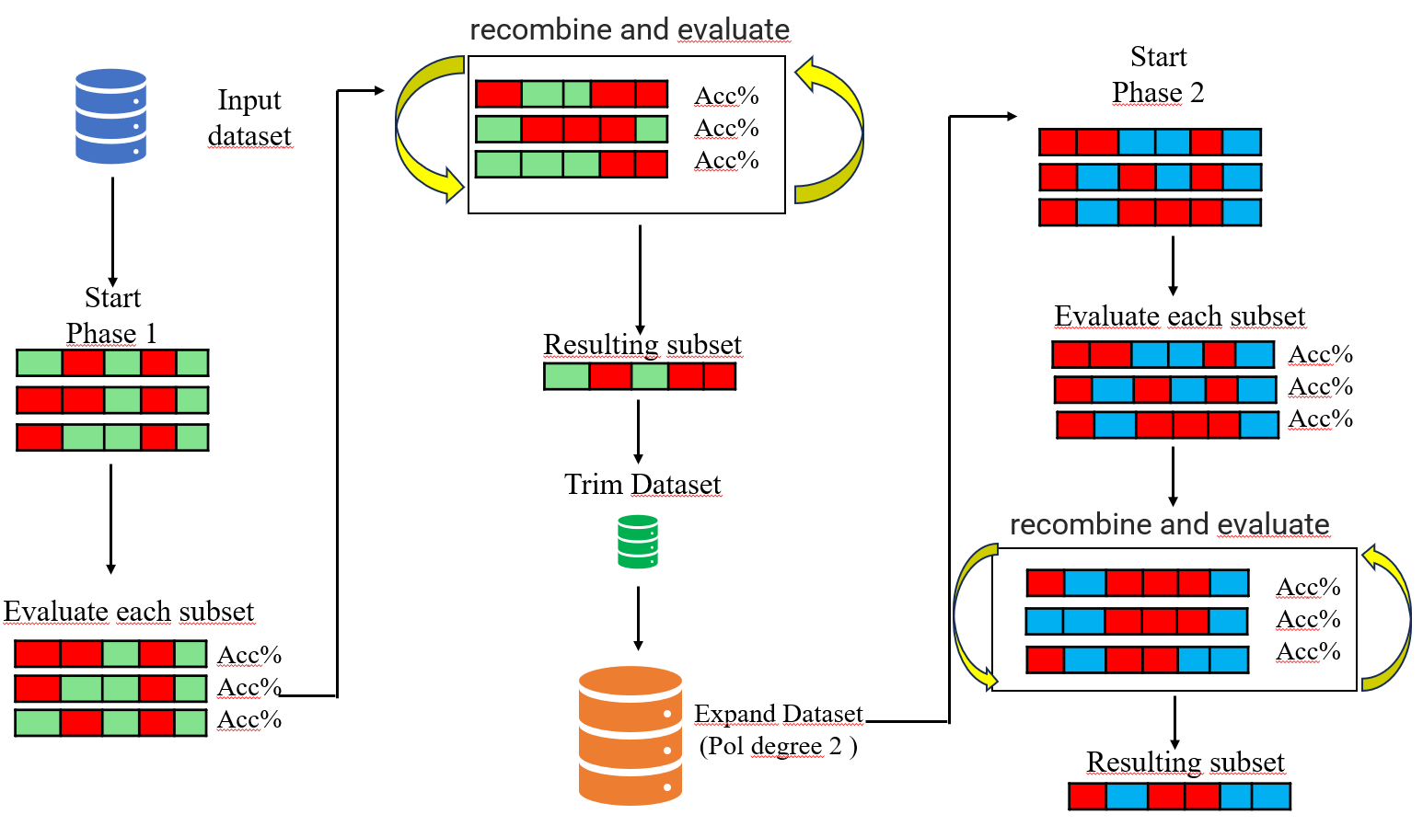
Workflow

Slide 7
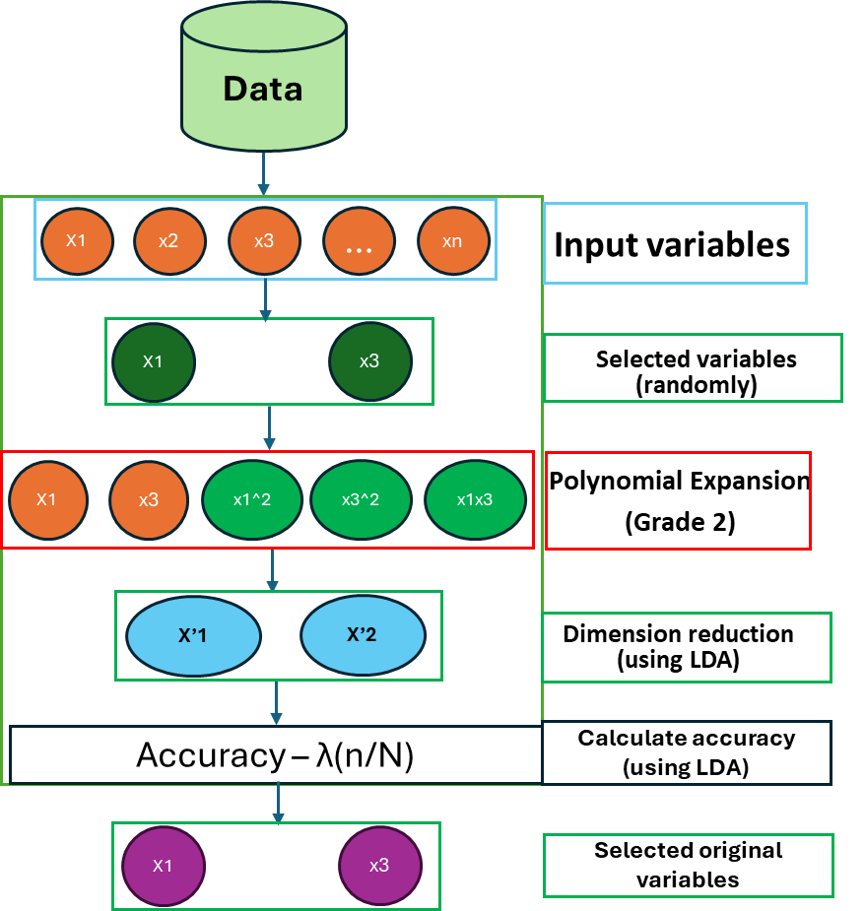
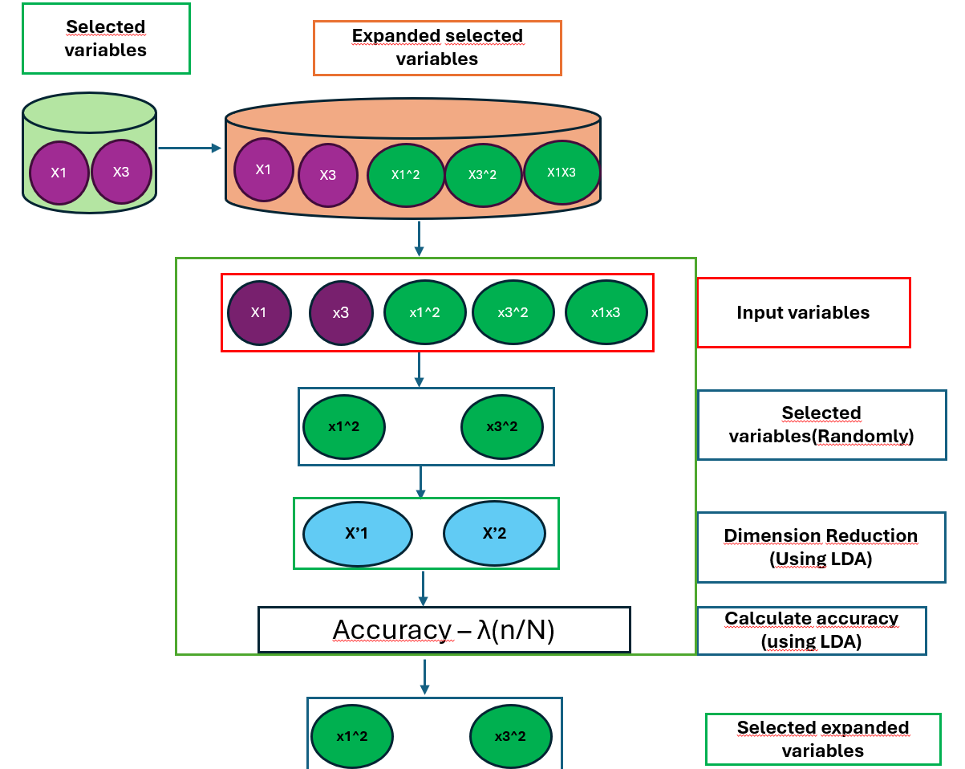
Proposed algorithm
Unified workflow
Step 1
Step 2

Slide 8
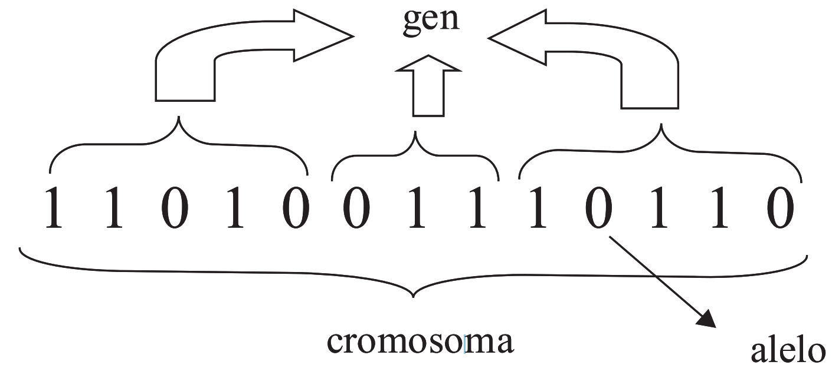
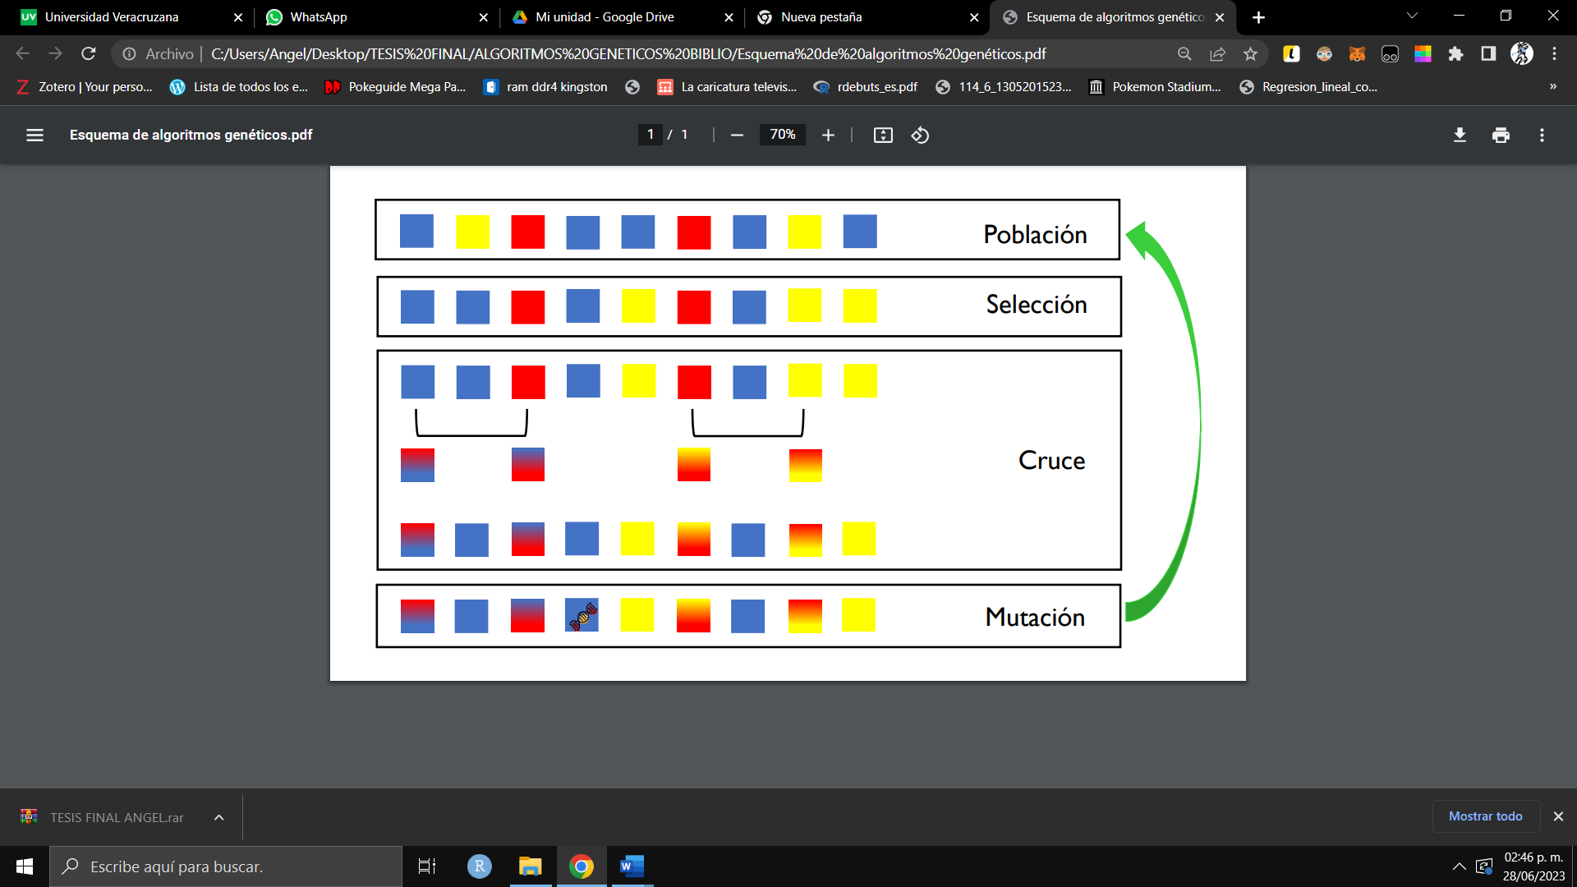
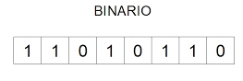
Genetic algorithms
It is a heuristic optimization technique based on replicating the mechanism of evolution and adaptation in living organisms.

Slide 9
Genetic algorithm to guide the search
Parameter / Component | Proposed Configuration
Representation | Binary (Chromosomes of length N)
Fitness Function | Accuracy – λ(n/N)
Parent Selection | Binary Tournament
Crossover Operator | Single-point Crossover
Mutation Operator | Bit-flip Mutation
Elitism | Top 2 individuals pass directly to the next generation
Replacement Mechanism | Generational with Elitism: Offspring replace the previous population while strictly preserving the best individuals to prevent the loss of optimal solutions.

Slide 10
Calibration frame
Parameter | Values
n_gen | 94
popSize | 64
p_cruza | 0.9
p_mut | 0.05
lambda | 0.01

Slide 11
Comparison Chart
Method | Model Type | Non-linearty | Visualization (Projections)
LDA | Statistical | Linear | Yes
QDA | Statistical | Quadratic | No
SVM (Poly 2) | Kernel-based | Hilbert Space (Degree 2) | No
SVM (Poly 3) | Kernel-based | Hilbert Space (Degree 3) | No
SVM (RBF) | Kernel-based | Hilbert Space (Radial Basis) | No
GNLPDA (Proposed) | stocastic | Non lineal | Yes

Slide 12
Datasets
Dataset | Samples | Variables | Class
iris | 150 | 4 | 3
penguins | 342 | 4 | 3
pimadiabetes | 768 | 8 | 2
wines | 178 | 13 | 3
Cebolla3D | 300 | 3 | 3
Cebolla10D | 300 | 10 | 3
Cebolla20D | 300 | 20 | 3
Breast Cancer (WDBC) | 569 | 30 | 2
Ionosphere | 351 | 34 | 2

Slide 13
Experimental Design
Validation Protocol
GNLPDA (Stochastic): 30 independent runs X 10-fold cross-validation (N=30 and fixed seed).
Reference (Deterministic): 1 run × 10-fold cross-validation (fixed seed).
Statistical Hypothesis
H₀: Accuracy(GNLPDA) ≤ Accuracy(Ref) Hₐ: Accuracy(GNLPDA) > Accuracy(Ref)
Statistical inference
Test: Wilcoxon Signed-Rank (One-sided).
Confidence level: 95% (α = 0.05).

Slide 14
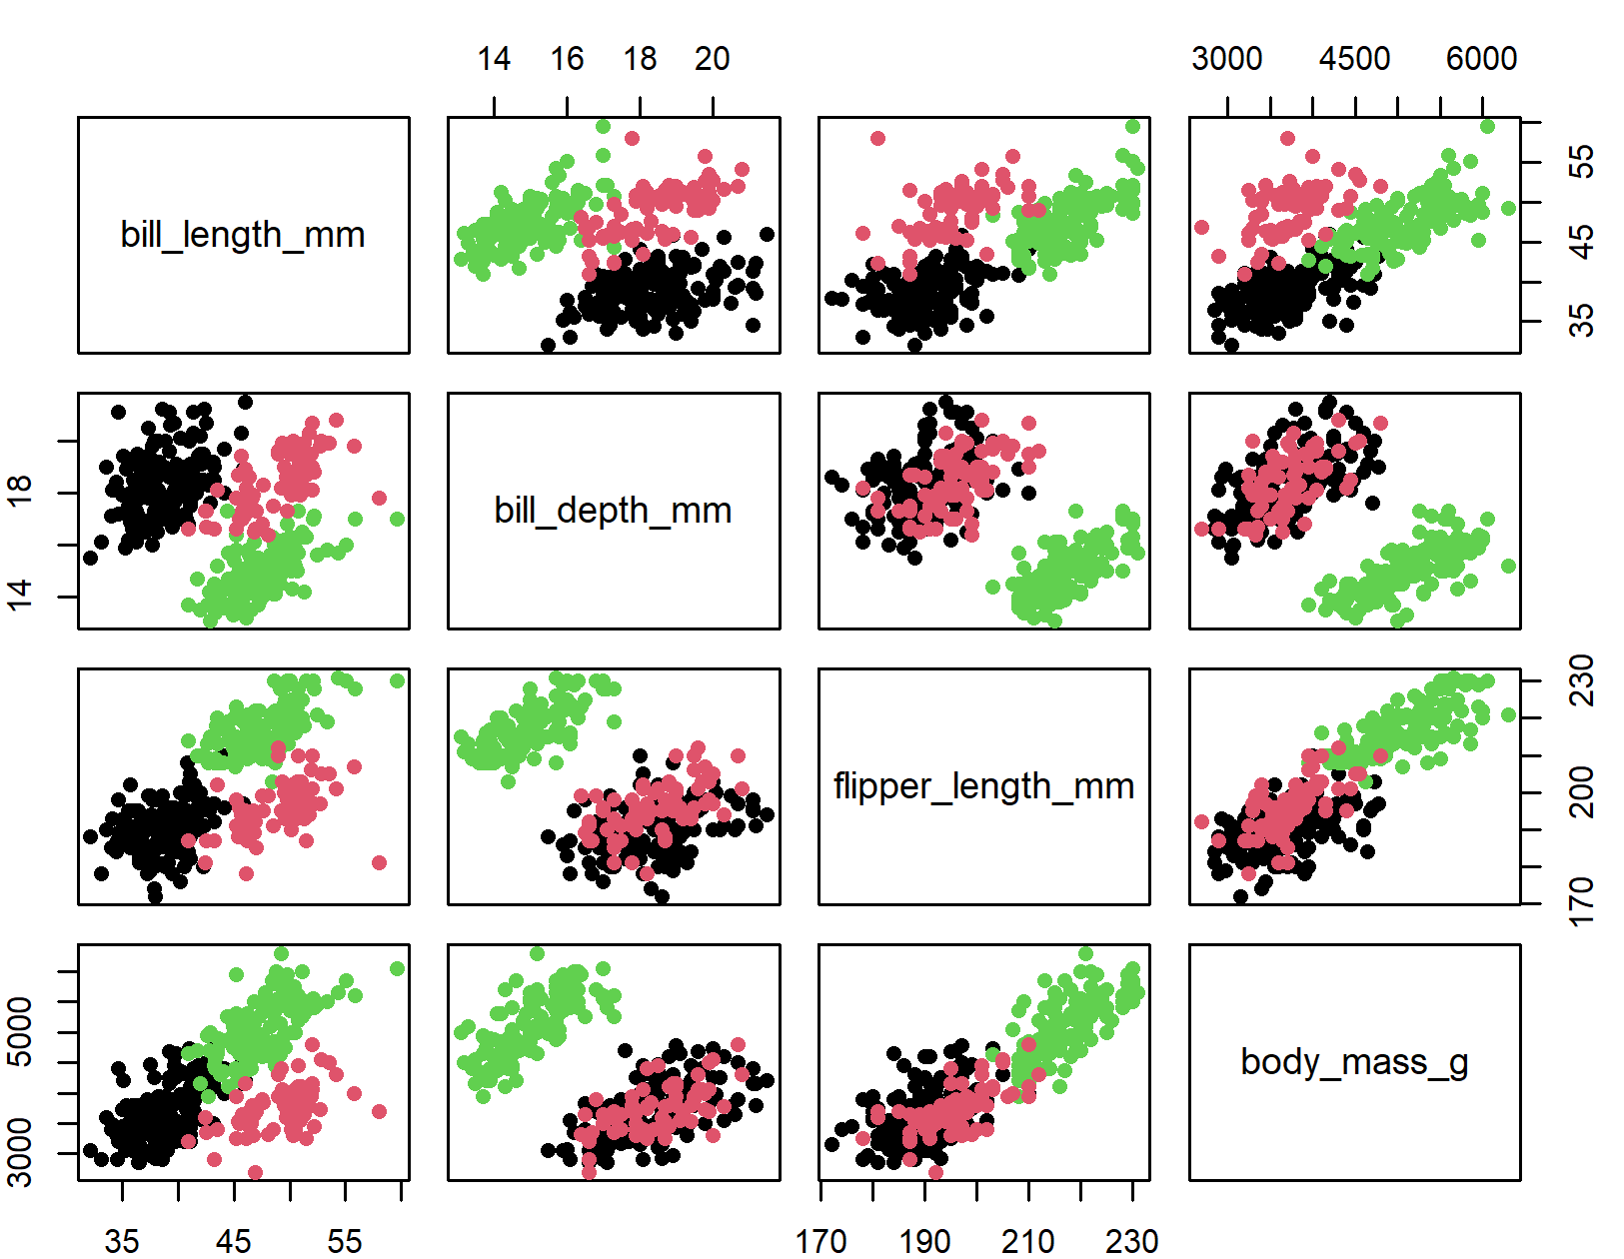
Preliminary results
Case 1: Palmer Penguins

Slide 15
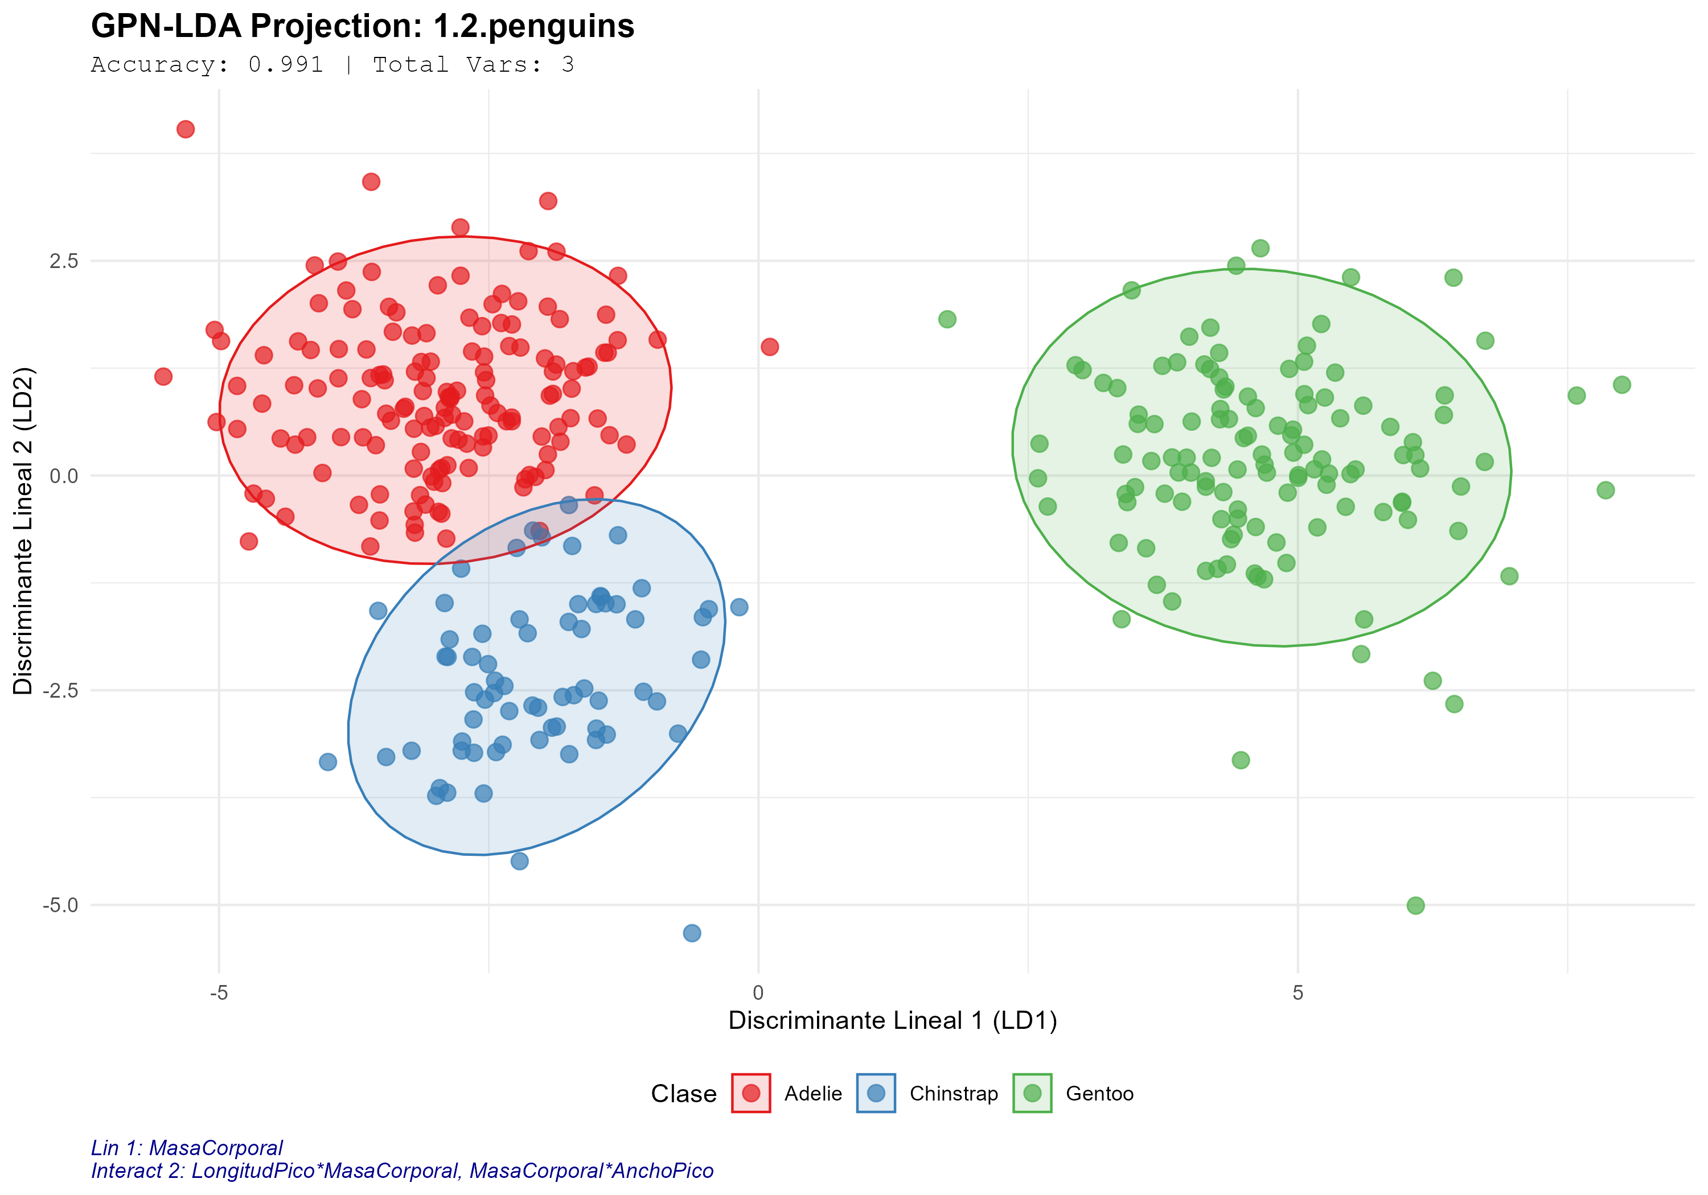
Preliminary results
Case 1: Palmer Penguins
Variables
3/4
Expanded terms
3/9

Slide 16
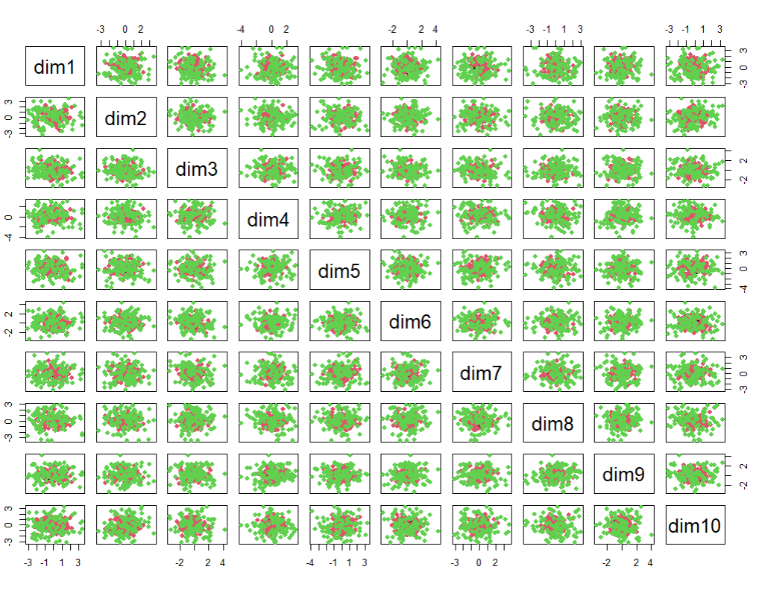
Preliminary results
Case 2: Cebolla 10D

Slide 17
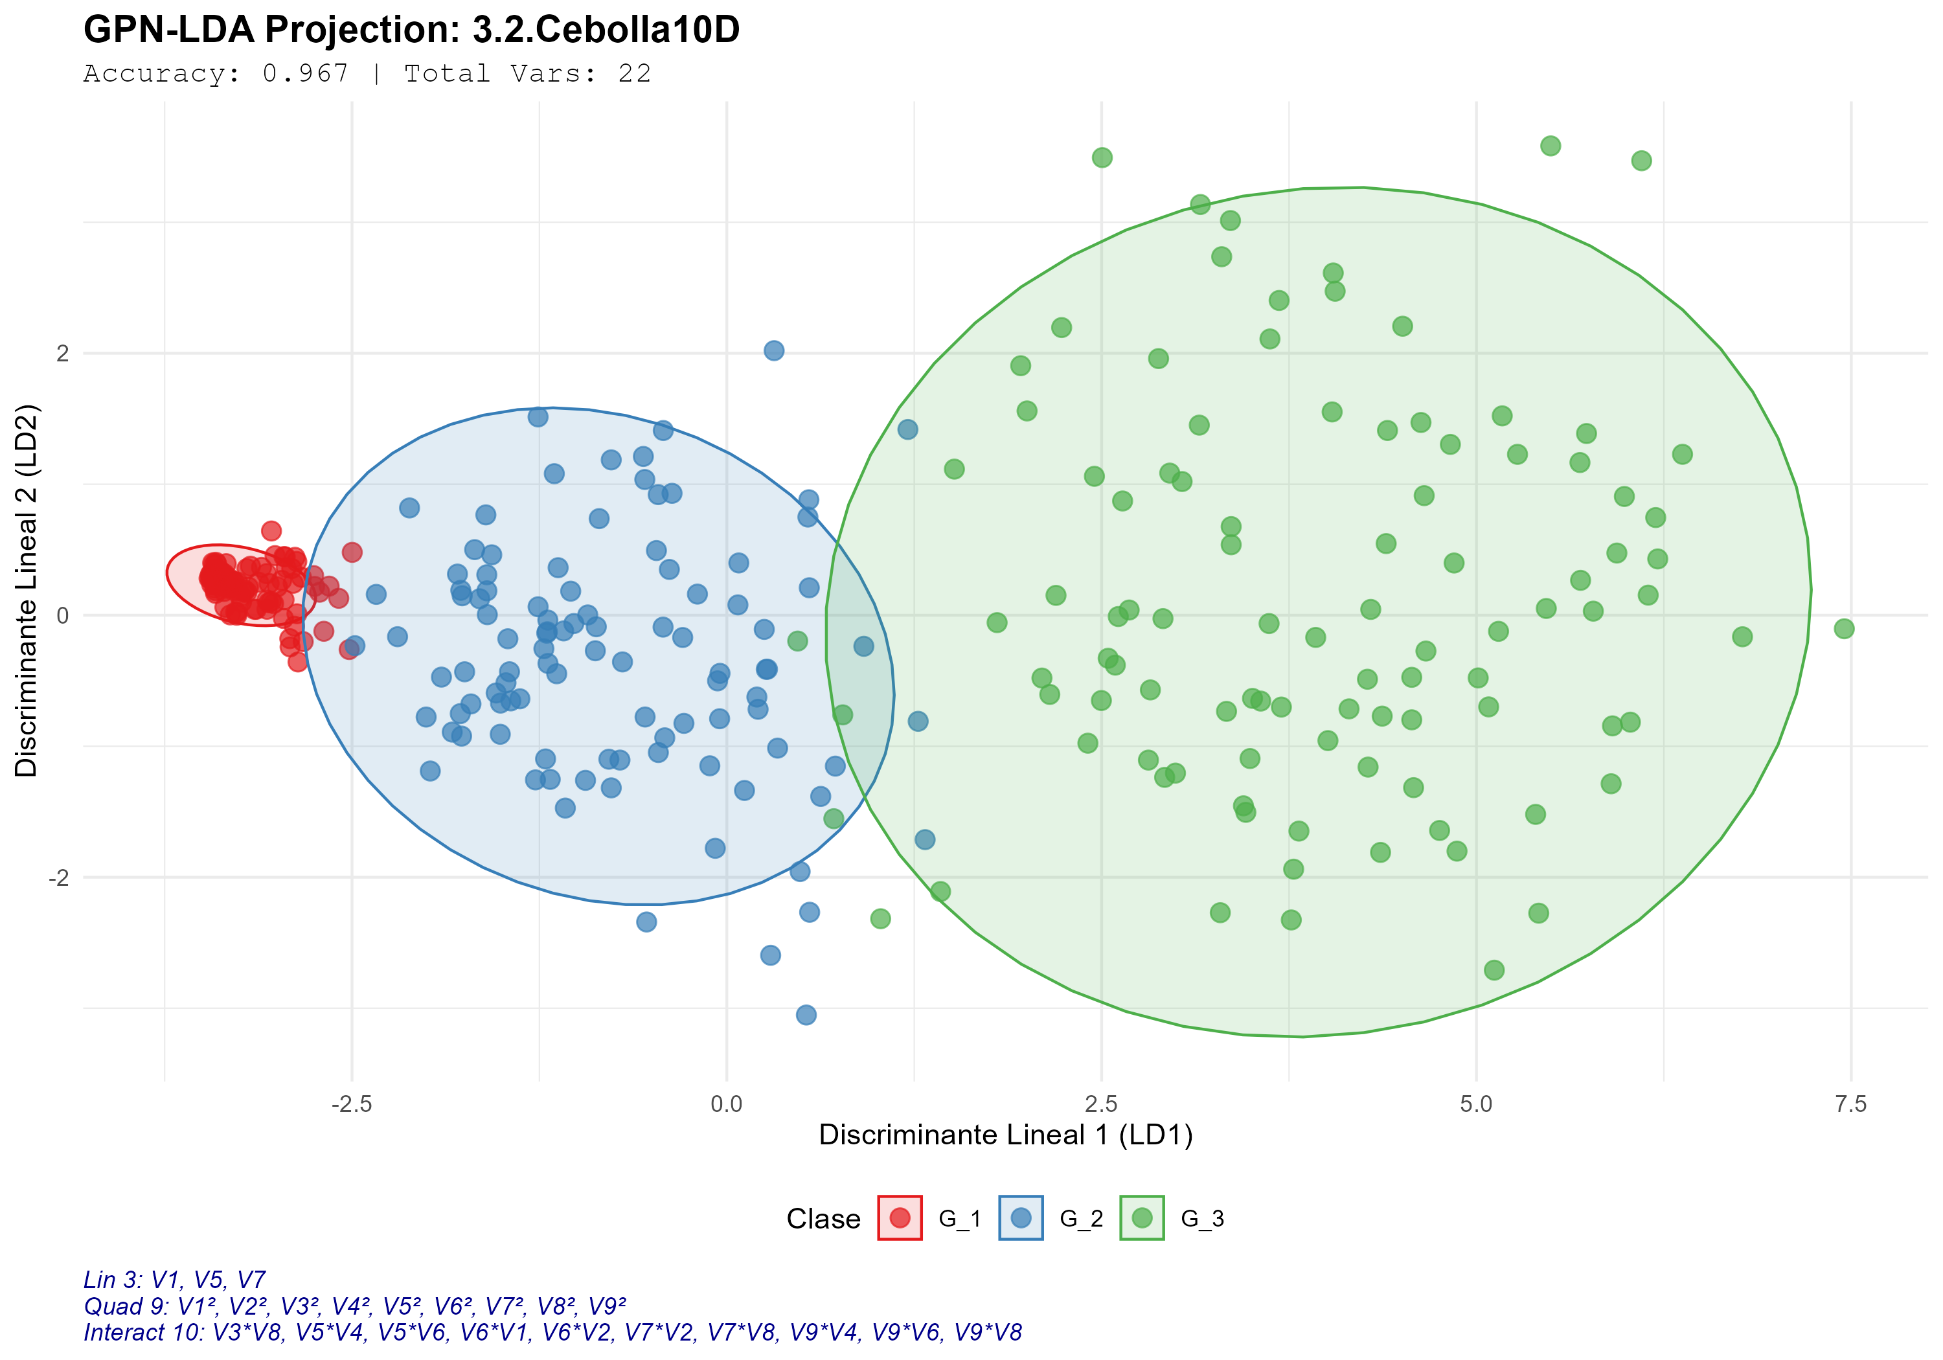
Preliminary results
Case 2: Cebolla 10D
Variables
9/10
Expanded terms
22/54

Slide 18
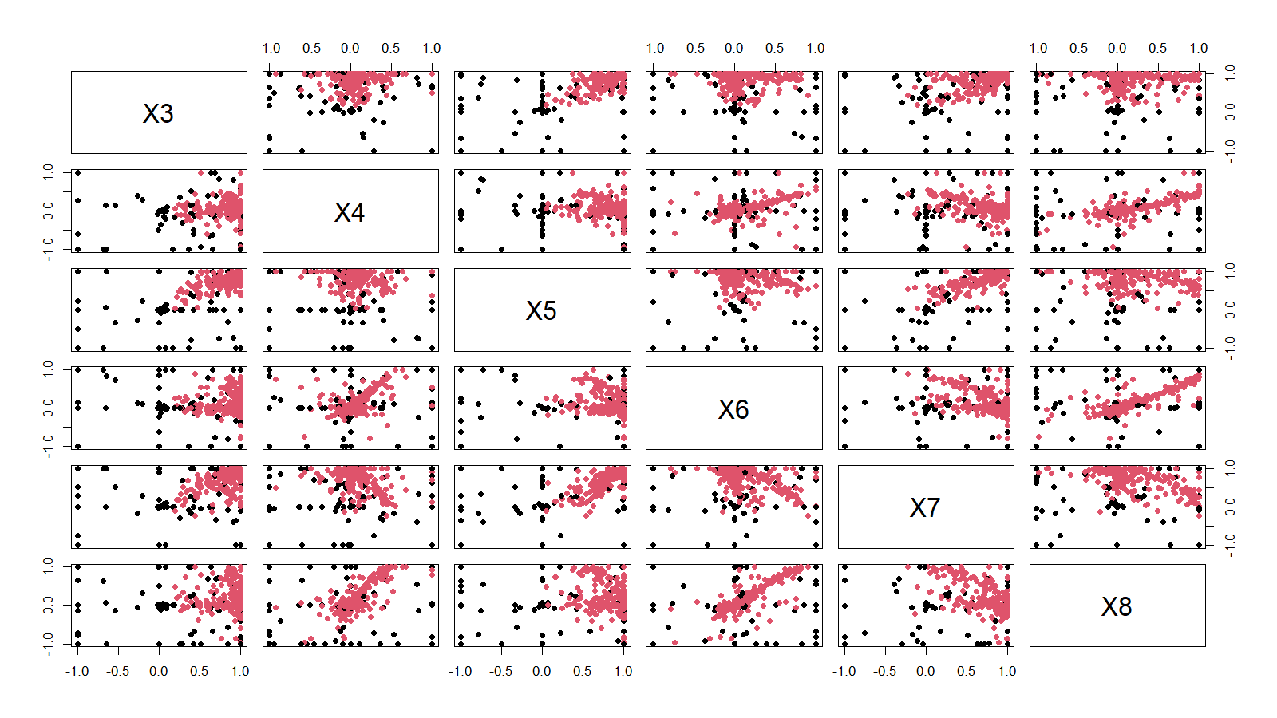
Preliminary results
Case 3: Ionosphere

Slide 19
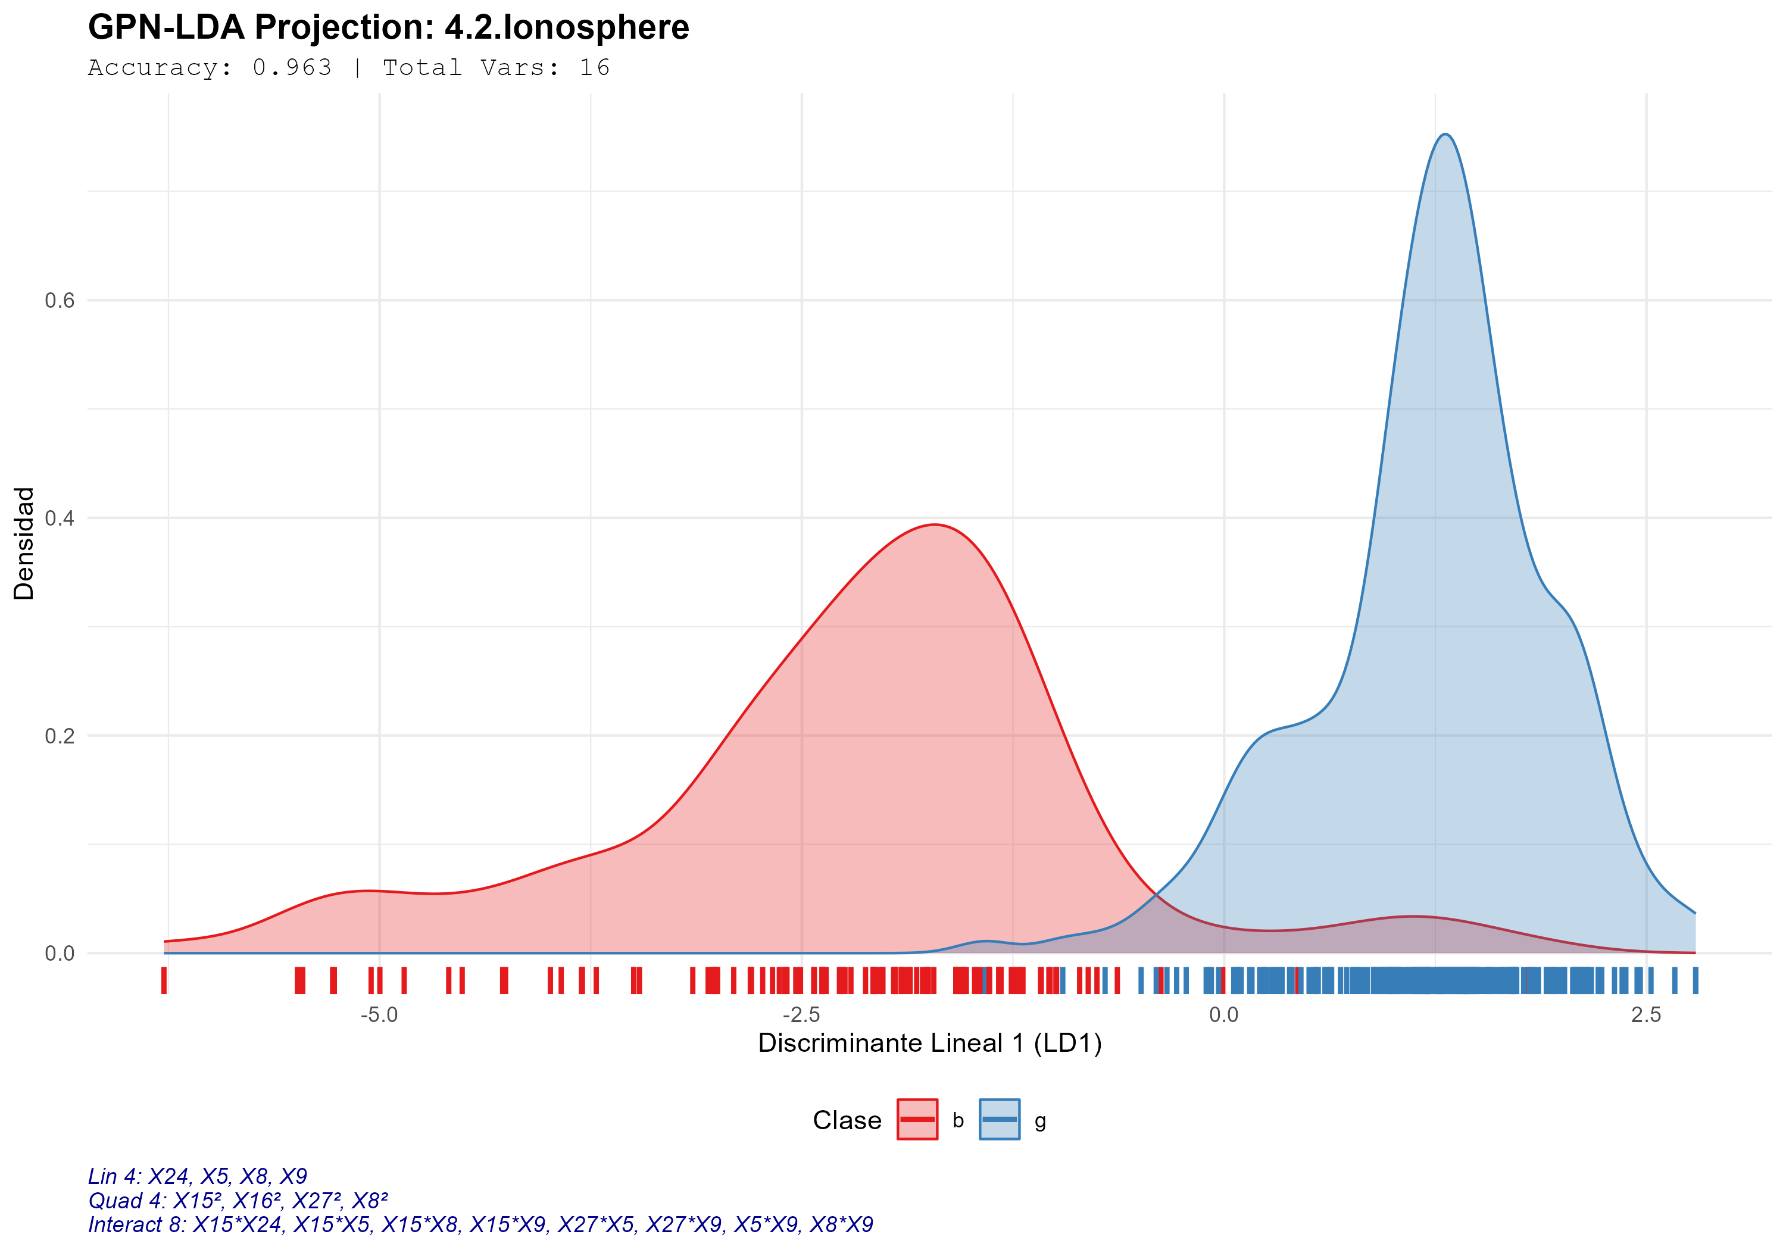
Preliminary results
Case 3: Ionosphere
Variables
7/34
Expanded terms
16/35

Slide 20
Preliminary results
Accuracy comparisons by method
Dataset | LDA | QDA | SVM Poly2 | SVM Poly3 | SVM GAUSS | GNLPDA
penguins | 0.99 ± 0.02 | 0.99 ± 0.02 | 0.88 ± 0.06 | 0.98 ± 0.02 | 0.98 ± 0.02 | 0.99 ± 0.00
Cebolla10D | 0.44 ± 0.10 | 0.87 ± 0.05 | 0.90 ± 0.05 | 0.51 ± 0.04 | 0.97 ± 0.03 | 0.96 ± 0.01
Ionosphere | 0.86 ± 0.06 | NA ± NA | 0.92 ± 0.04 | 0.84 ± 0.04 | 0.95 ± 0.03 | 0.93 ± 0.01

Slide 21
Preliminary results
Metrics of the proposed algorithm
Dataset | No. Vars | Vars E1 | Vars E2 | Accuracy | Precision | Recall | F1Score | Time (S)
penguins | 4 | 3.00 ± 0.00 | 3.00 ± 0.00 | 0.99 ± 0.00 | 0.99 ± 0.00 | 0.98 ± 0.00 | 0.99 ± 0.00 | 1.46 ± 1.32
Cebolla10D | 10 | 9.00 ± 0.00 | 22.33 ± 3.10 | 0.96 ± 0.01 | 0.96 ± 0.01 | 0.96 ± 0.01 | 0.96 ± 0.01 | 1892.04 ± 695.36
Ionosphere | 34 | 7.93 ± 1.14 | 22.90 ± 6.70 | 0.93 ± 0.01 | 0.98 ± 0.01 | 0.84 ± 0.03 | 0.90 ± 0.02 | 2282.16 ± 597.35

Slide 22
For the next session
Present results using repeated k-folds adding statistical tests.

Slide 23
References
Hu, X., Liu, W., & Xing, X. (2025). An Innovative Inter-Spectral Distance-Based Approach to Analyzing MALDI-TOF Mass Spectra of Closely Related Microbial Species. Rapid Communications in Mass Spectrometry, 39(23), e10121.
Li, S., Zhang, X., Luo, C., Chen, Y., & Zhao, S. (2024). Global and local structure projection learning for image feature extraction. The Journal of Supercomputing, 80(14), 21001–21022.
Liu, Y., & Guo, S. (2024). Weighted Linear Discriminant Analysis: An Effective Feature Extraction Method for Multi-Class Imbalanced Datasets. Symmetry, 16(12), 1656.
Song, Z., Li, M., Xiong, P., Tu, S., Xiao, H., Pang, S., Li, H., Pang, S., & Xiao, H. (2025). Intelligent sensing of congou black tea fermentation process based on active terahertz low-frequency excitation. Measurement, 119047.
Sudibyo, U., Rustad, S., Andono, P. N., Fanani, A. Z., & Supriyanto, C. (2024). iLDA: A new dimensional reduction method for non-Gaussian and small sample size datasets. Egyptian Informatics Journal, 27, 100533.
Sudibyo, U., Rustad, S., Nurtantio, P., & Fanani, A. Z. (2025). DRCT: A Novel Method for Dimensional Reduction on High-Dimensional Data. International Journal of Intelligent Engineering & Systems, 18(3).
Zheng, P., Solomon Adade, S. Y. S., Rong, Y., Zhao, S., Han, Z., Gong, Y., Hao, Q., Wang, X., & Lin, H. (2024). Online system for monitoring the degree of fermentation of oolong tea using integrated visible--near-infrared spectroscopy and image-processing technologies. Foods, 13(11), 1708.

Slide 24
State of the art for Non-linearly
Year | Authors | Method | Focus / Solves | Limitation
2025 | Hu et al. | Inter-Spectral Distance | Mass spectra of similar species. | Domain-specific: Limited to spectral data.
2024 | Sudibyo et al. | iLDA (Iterative) | Non-Gaussian dimensional reduction. | Unstable: Fails with small sample sizes.
2023 | Reza et al. | Integrated RBF Kernel | Complex clinical prediction (PIMA). | Heuristic: Trial-and-error parameter tuning.

Slide 25
State of the art for Dimensional Reduction
Year | Authors | Method | Focus / Solves | Limitation
2025 | Sudibyo et al. | DRCT | Ultra-high dimensional reduction. | High Cost: Heavy computational load.
2024 | Liu & Guo | Weighted LDA | Imbalanced dataset feature extraction. | Bias Risk: Overfits to minority classes.
2024 | Li et al. | Structure Projection | Global/local image feature learning. | Lacks Parsimony: Ignores minimal subsets.

Slide 26
Variable reduction
Dataset | Vars E1 (%) | Vars E2 (%)
penguins | 25.00 ± 0.00 | 66.67 ± 0.00
Cebolla10D | 10.00 ± 0.00 | 58.64 ± 5.74
Ionosphere | 76.67 ± 3.36 | 48.05 ± 7.57

